Slide 1
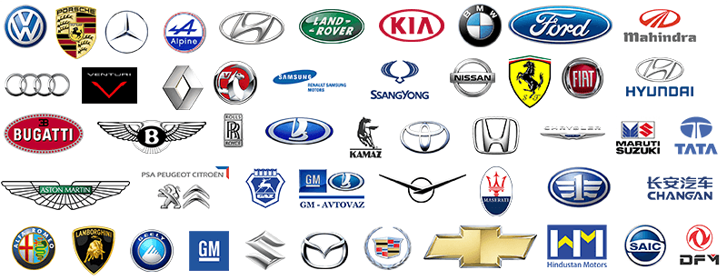
What makes a car efficient or safe?
Fandi Lin (fl3bf)
Greg Gardner (gmg5dc)
Tianye Song (ts7fx)
Yizhe Ge (yg2kj)
Notes:
We are a group of guys who are interested in exploring various characteristics of cars. Additionally, we wanted to help consumers in making their decisions regarding what car to purchase. We hoped to learn what factors influence the insurance risk rating of a car by investigating the data set of our selection. We also wanted to investigate what factors contributed to an economic mpg rating for a car.

Slide 2
introduction
Our data:
Automobiles dataset
From UC Irvine machine learning repository
Came in as a comma delimited file
For fundamental queries, took it as it is
Poured into pandas.dataframe
But…
needed clean data for advanced queries
Different approach for different queries
Notes:
Our selected data set describes three aspects that concerns auto insurance companies:
1. characteristics of an auto, like horsepower and mpg
2. its insurance risk rating, and
3. its normalized losses in use as compared with other cars.

Slide 3


Analysis: Make vs mpg
The Most Efficient:
Make | City-Mpg | Highway-Mpg
Honda | 49 | 54
Chevrolet | 47 | 53
Nissan | 45 | 50
…...
The Most Inefficient:
Make | City-Mpg | Highway-Mpg
Mercedez-benz | 14 | 16
Jaguar | 13 | 17

Slide 4
Analysis: CYLINDERS vs mpg
Regrouped the raw data
More cylinders lower mpg

Slide 5
Analysis: Drive-wheels vs mpg
Fwd is much more fuel efficient
than rwd.
Drive-Wheels | City-Mpg | Highway-Mpg
fwd | 28.15254 | 34.07627
4wd | 24.00000 | 27.87500
rwd | 20.62667 | 25.65333
Notes:
Rwd offers numerous benefits over its front-powered competition, including better handling and grip in certain driving situations, more balanced weight distribution and easier servicing. The ability to do doughnuts in snowy parking lots is another plus.
Improved fuel economy was arguably the No. 1 reason for the transition to front-wheel drive over the last three decades. Allow cars to be made smaller and lighter.

Slide 6
Analysis: Drive-wheels vs horsepower
Rwd tends to have the
highest horsepower.

Slide 7
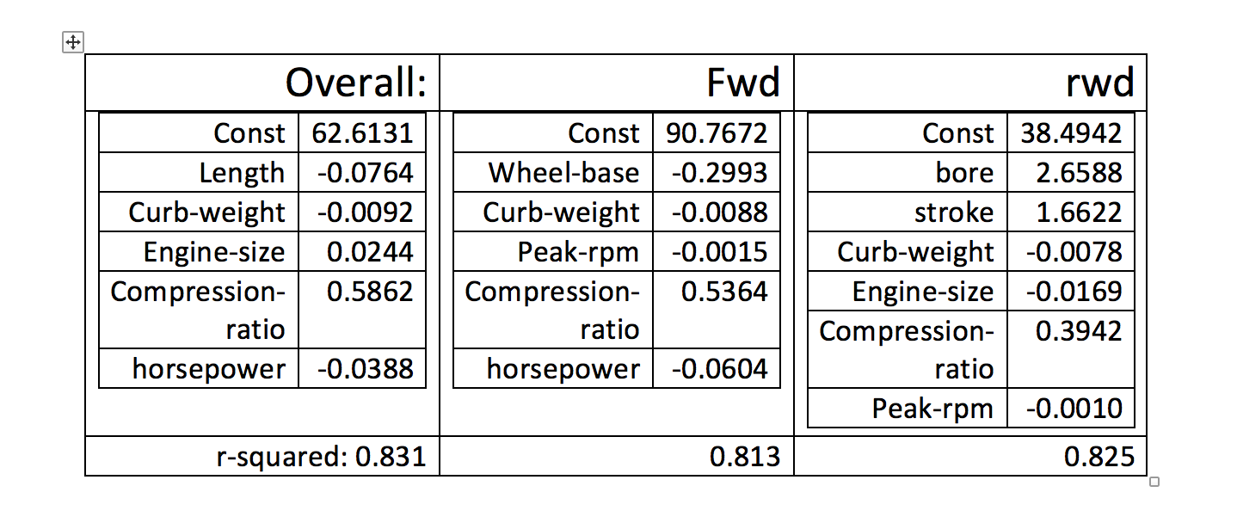
LINEAR REGRESSION

Slide 8
Predicting Insurance Risk
Decision Tree Classifier
Features selected by cross-validation
Most predictive model:
wheelbase
width
price
Accuracy of 80% on test set
Is wheelbase < x₁?
Predict: y₁
Is width < x₂?
Predict: y₂
Is … ?

Slide 9
Conclusions
mpg ~ spatial attributes + engine specs
Insurance risk rating ~ wheel base, width and price.
our findings can generate 80 % accurate estimate for insurance risk rating.
Assist consumers to make better judgement on auto purchase.

Slide 10
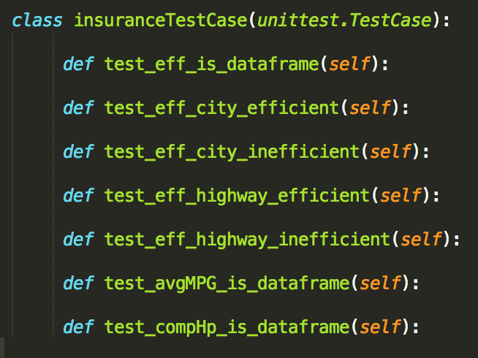
Improvements & Unit tests
1. Modularizing for better readability and reusability
2. expand vertically on fundamental queries
3. find more data for the data set
4. try agile methodologies

